Slide 1
Identifying Conditions for Autonomous Dynamic Gait Transitions in Quadruped Robots Intelligent Robotics Emanuele Cuzzocrea Prof. Alberto Finzi

Slide 2
Index
01
02
03
04
05
06
Introduction
Reward Machines
RM for Quadruped Locomotion
Robust gait transitions
Conclusions
Personal contribution

Slide 3
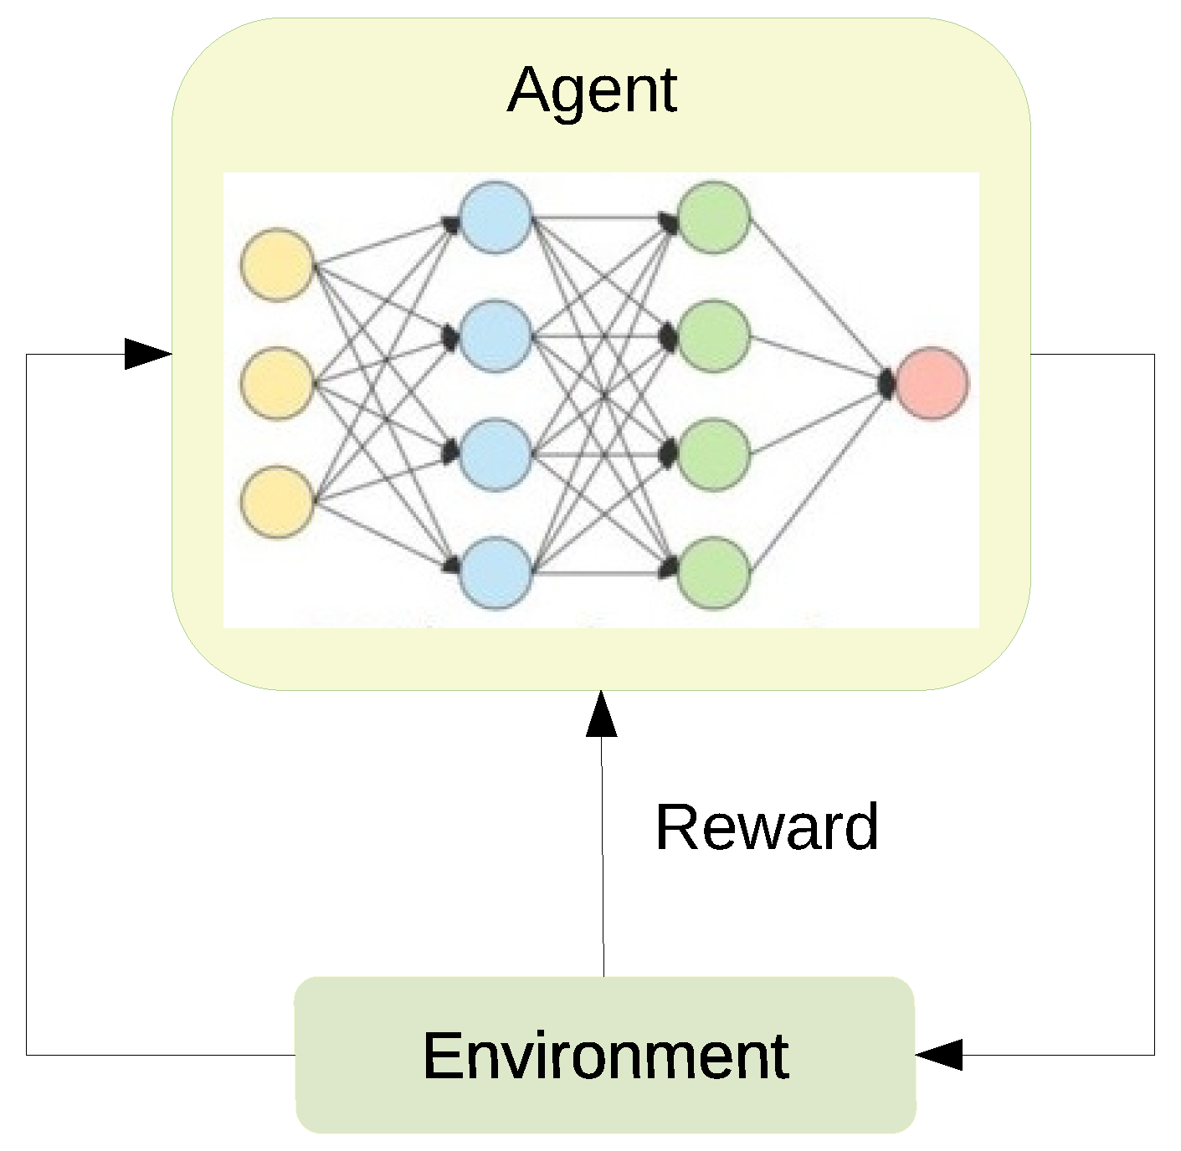
1. Introduction
Using deep reinforcement learning for controlling a quadruped robot
Use reward machines for learning different gaits
Explore transitions of policies
Condition for autonomous transitions for the higher level control system

Slide 4
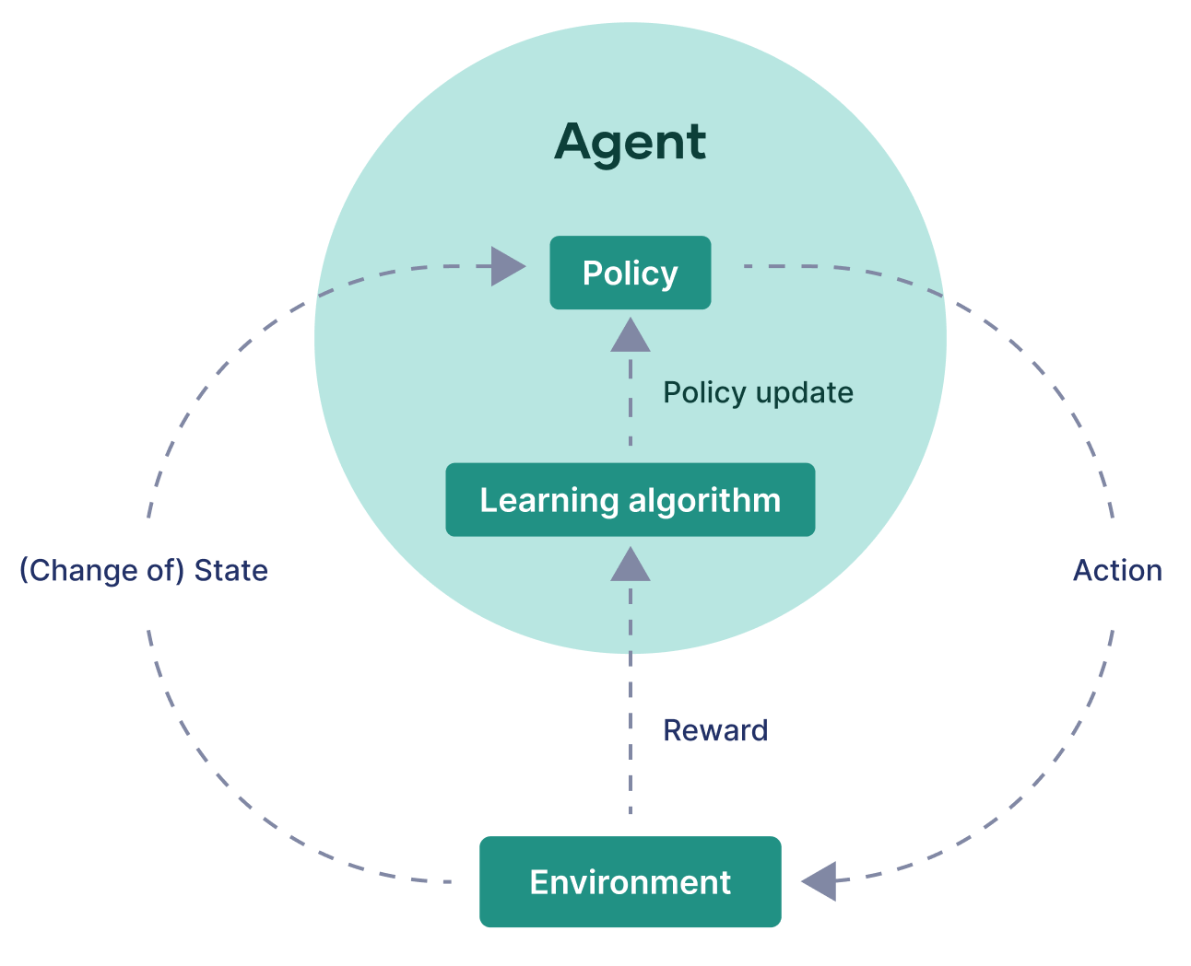
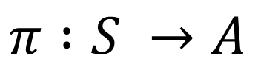
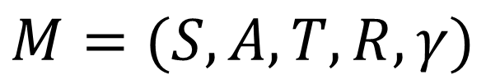
Reinforcement learning
$$M=(S,A,T,R,γ)$$
$$π :S →A$$

Slide 5
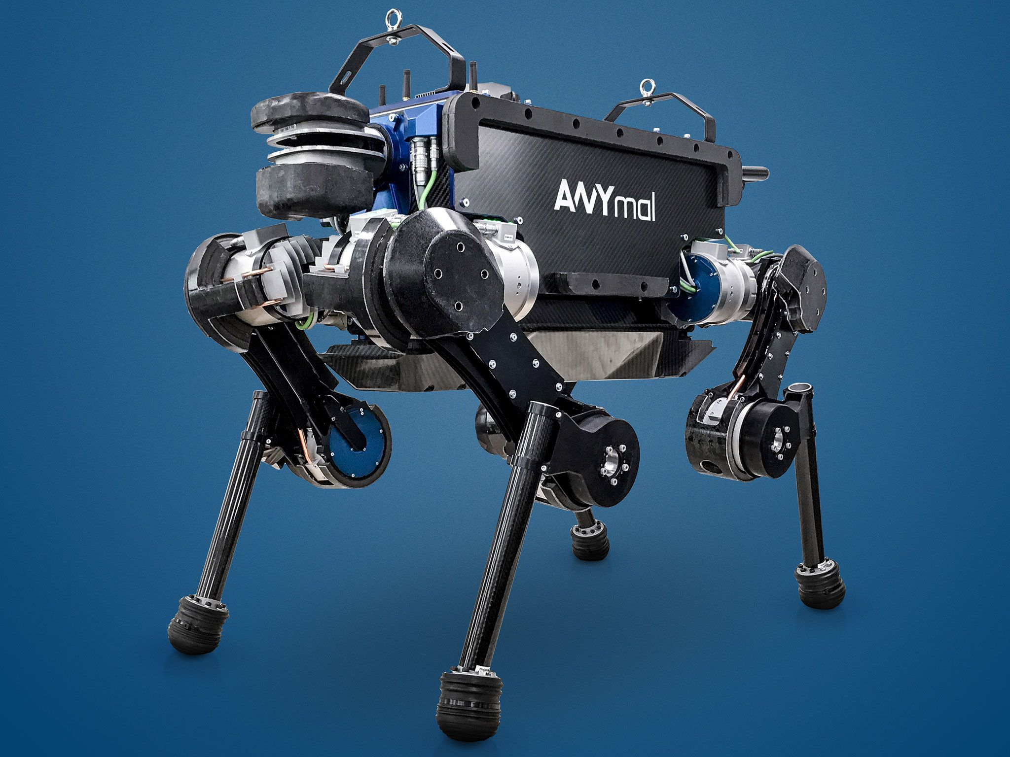
Robot used: ANYmal B
Quadruped robot developed by ANYbotics
4 legs with each three identical motors (ANYdrives): electrically actuated and can sense force
Compliant walking
Depth cameras, LIDAR, …

Slide 6
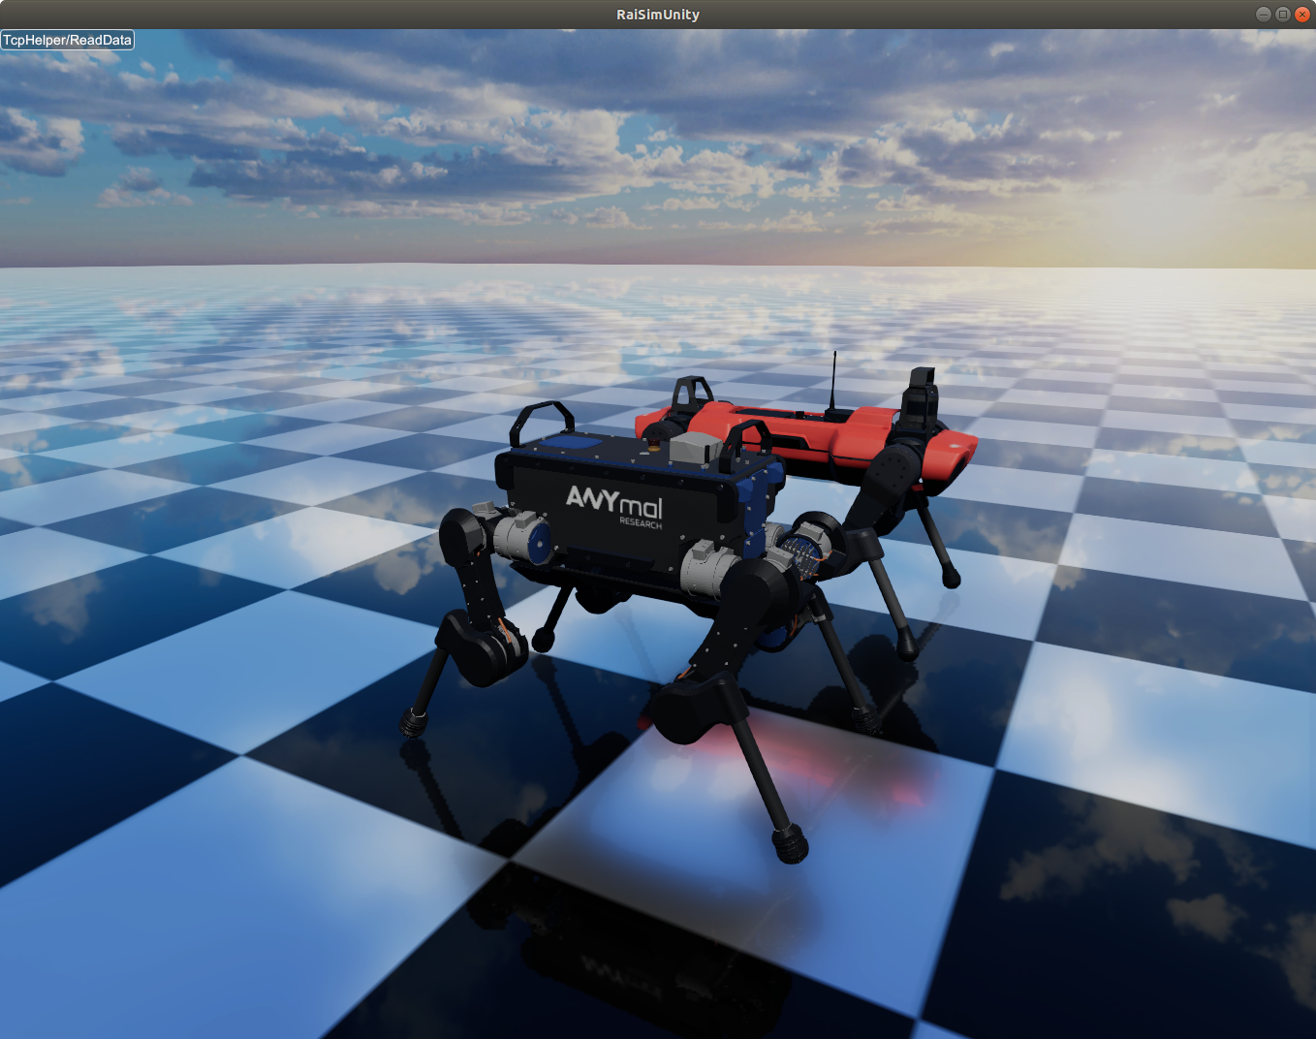
Simulator: Raisim
Cross-Platform multi-body physics engine for robotics and AI
Deep Reinforcement Learning
Uses Unity or Unreal for visualization
Pytorch
Best, after Isaac Gym from NVIDIA

Slide 7
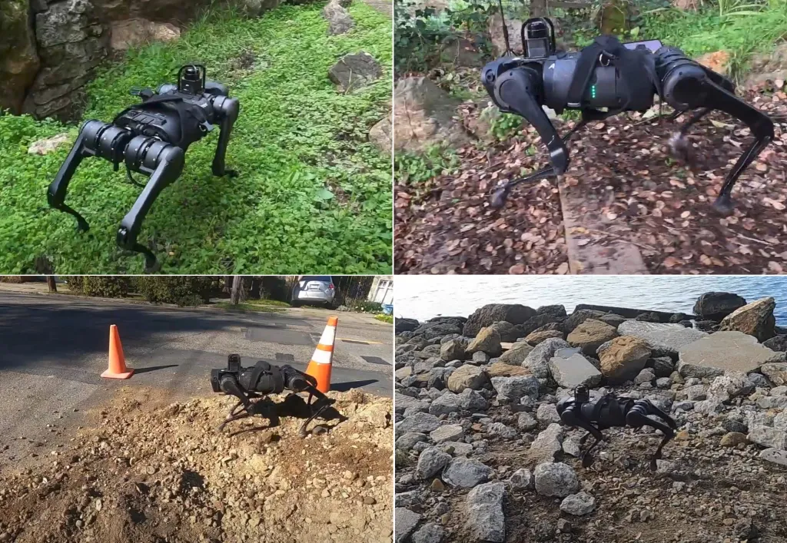
Necessity of different gaits

Slide 8

2. Reward Machines
Used to manage milestone sub-goals in larger tasks
Addressing issues of sparce or non-Markovian reward functions
Specify sub-goals through a finite-state automaton
Keeps the reward function Markovian
Can speed up the training phase

Slide 9
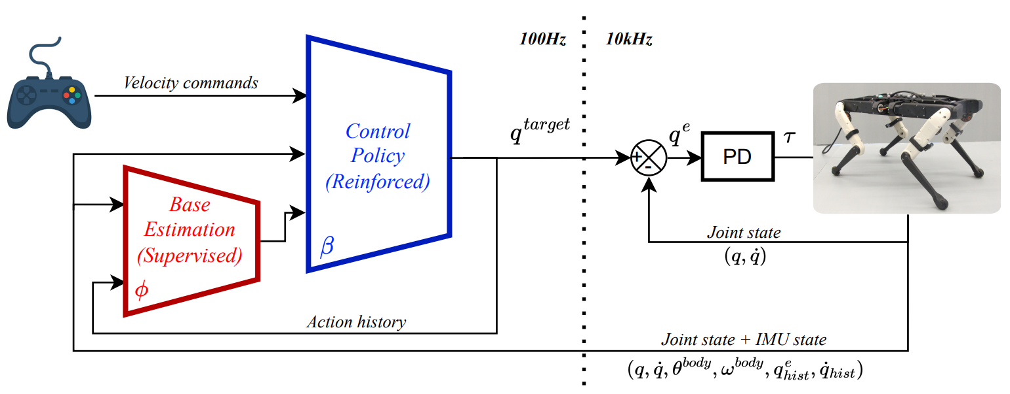
3. RM for Quadruped Locomotion

Slide 10
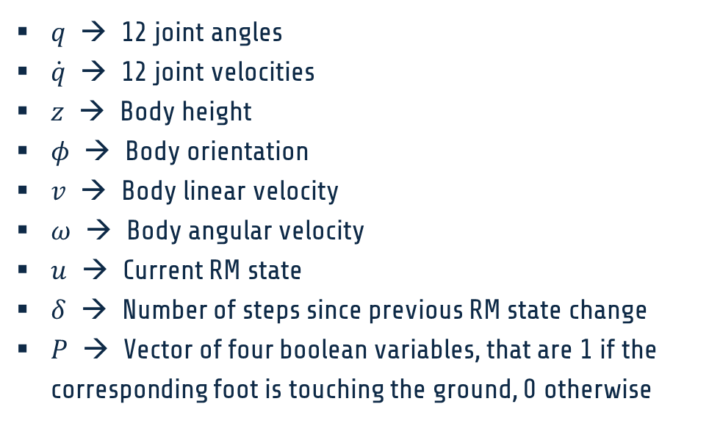
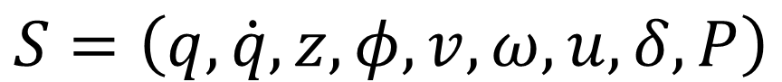
State space
$q$ → 12 joint angles
$\dot{q}$ → 12 joint velocities
$z$ → Body height
$φ$ → Body orientation
$v$ → Body linear velocity
$ω$ → Body angular velocity
$u$ → Current RM state
$δ$ → Number of steps since previous RM state change
$P$ → Vector of four boolean variables, that are 1 if the corresponding foot is touching the ground, 0 otherwise
$$S=\left(q,\dot{q},z,φ,v,ω,u,δ,P\right)$$

Slide 11
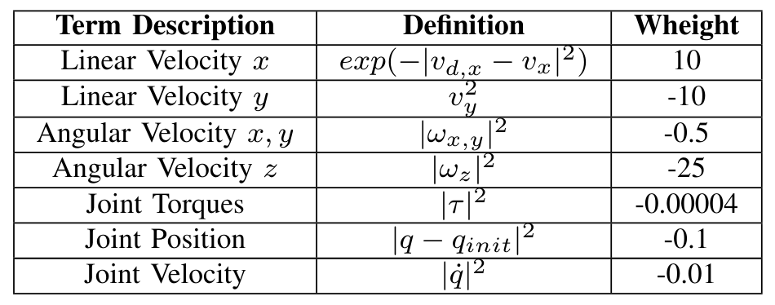
Reward function (fixed forward velocity)

Slide 12
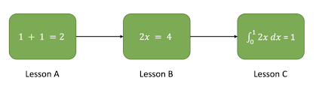
Curriculum learning
Increase slowly the weight of the penalties
The robot can find a local reward maximum by doing nothing!
Fondamental when not using reward machines
Optional when using reward machines
The training can become very slow

Slide 13
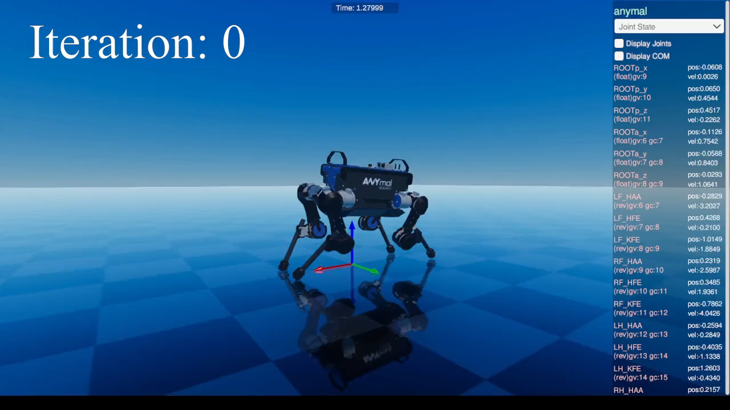
Training of trot gait

Slide 14
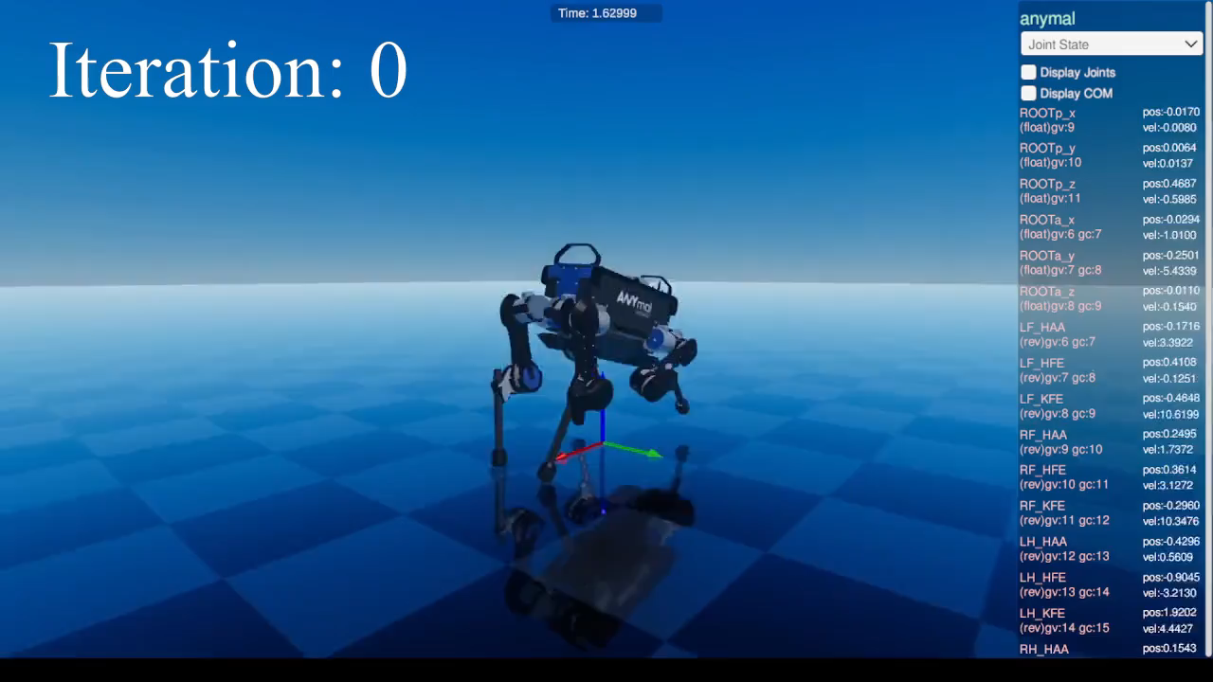
Training of bound gait

Slide 15
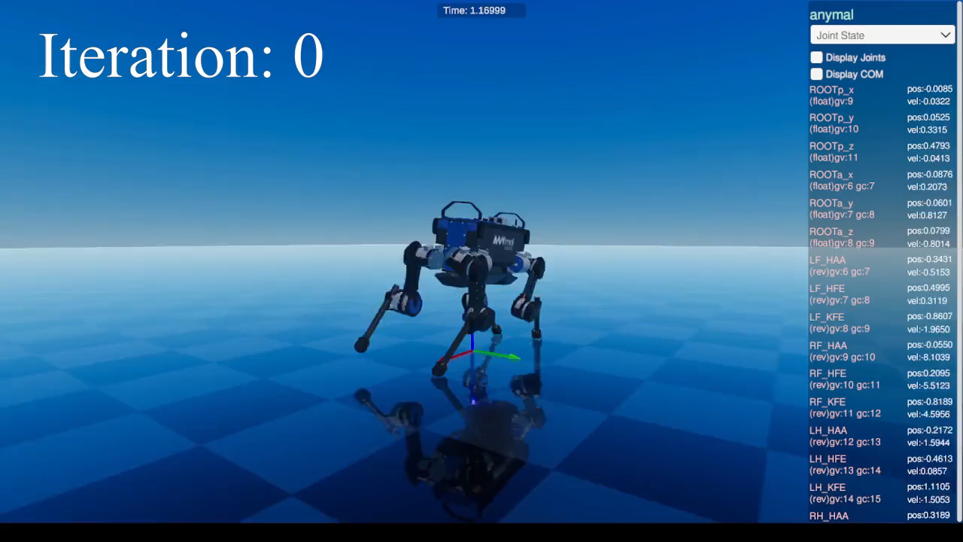
Training of pace gait

Slide 16

4. Robust gait transitions
Specific training can be done on transitions
Domain randomization
External disturbances

Slide 17
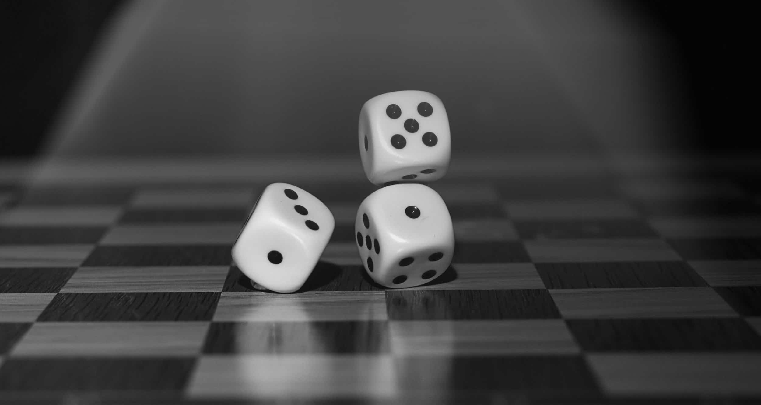
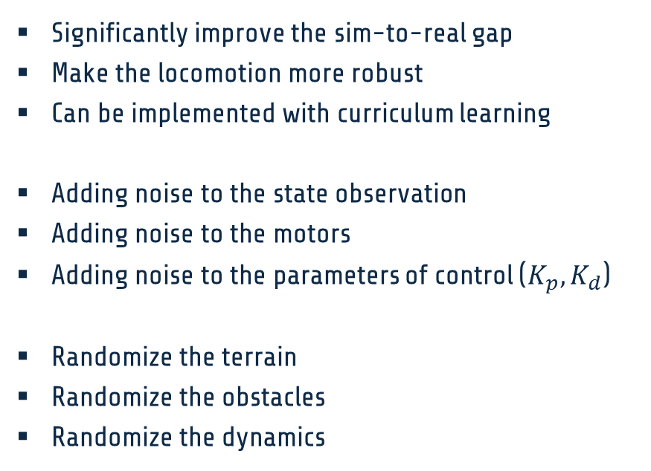
Domain and dynamic randomization
Significantly improve the sim-to-real gap
Make the locomotion more robust
Can be implemented with curriculum learning
Adding noise to the state observation
Adding noise to the motors
Adding noise to the parameters of control ($K_{p},K_{d}$)
Randomize the terrain
Randomize the obstacles
Randomize the dynamics

Slide 18
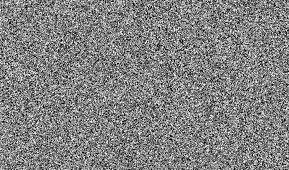
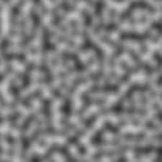
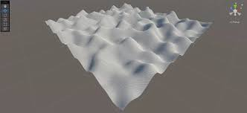
Terrain randomization with Perlin noise
Type of gradient noise developed by Ken Perlin in 1983
Many uses: procedurally generating terrain, pseudo-random changes to variables, assisting in the creation of image textures
Can be defined for any number of dimensions
Change terrain each 5 iterations for limiting computational cost

Slide 19
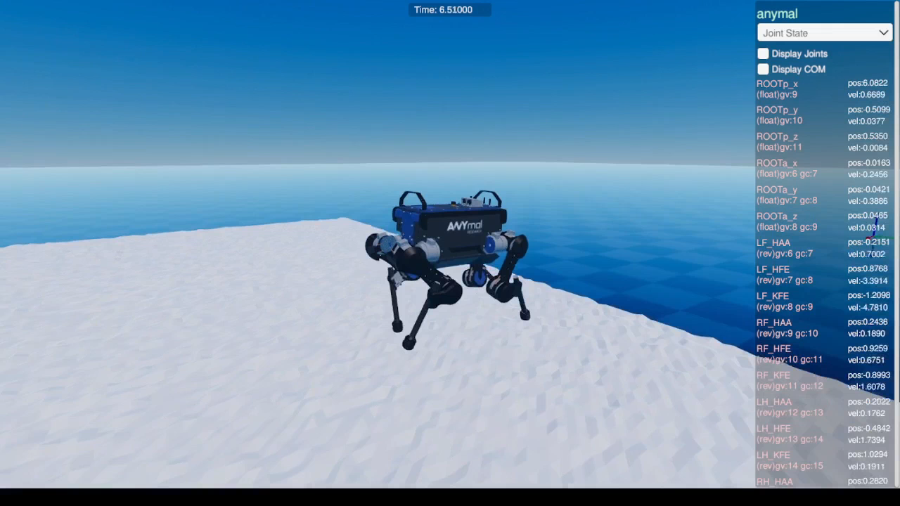
Terrain randomization with Perlin noise

Slide 20
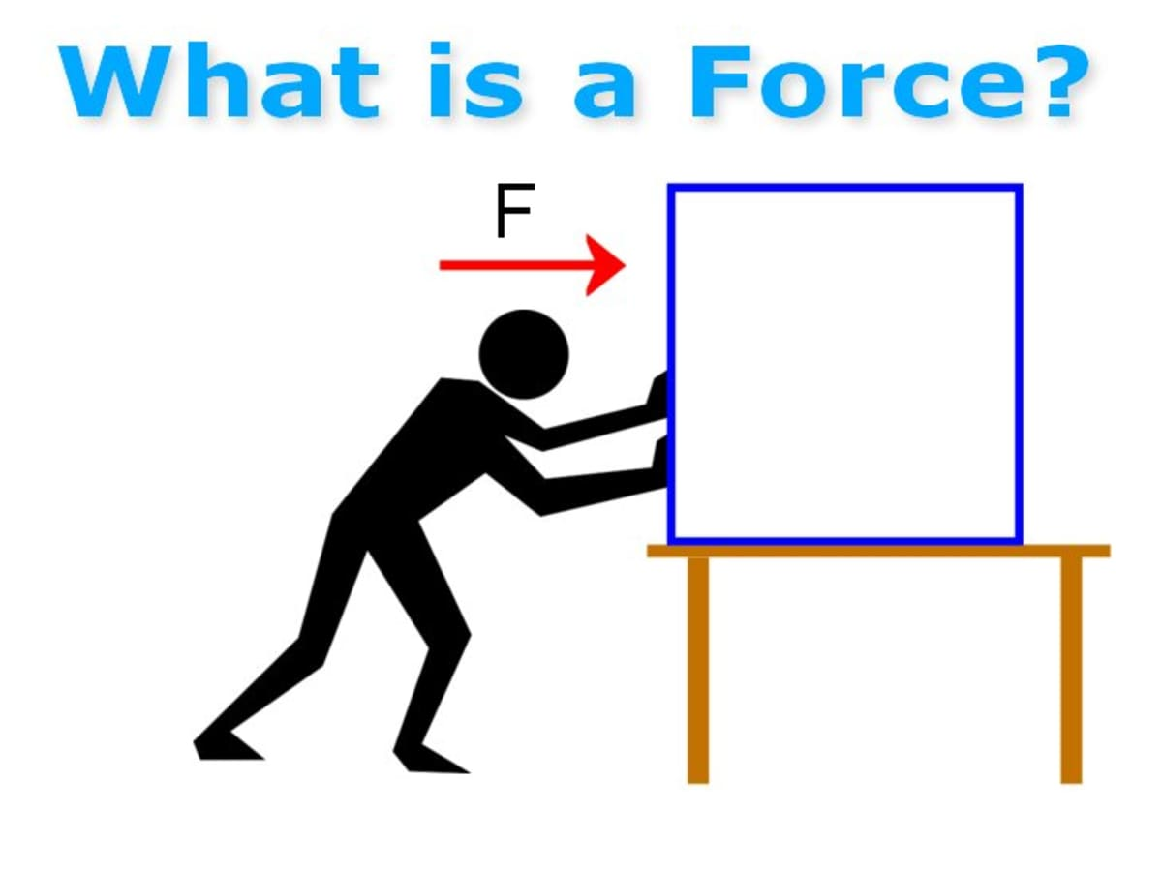
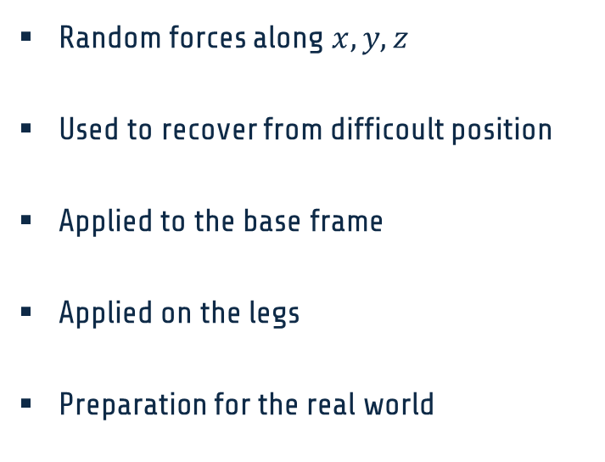
External disturbances
Random forces along $x,y,z$
Used to recover from difficoult position
Applied to the base frame
Applied on the legs
Preparation for the real world

Slide 21
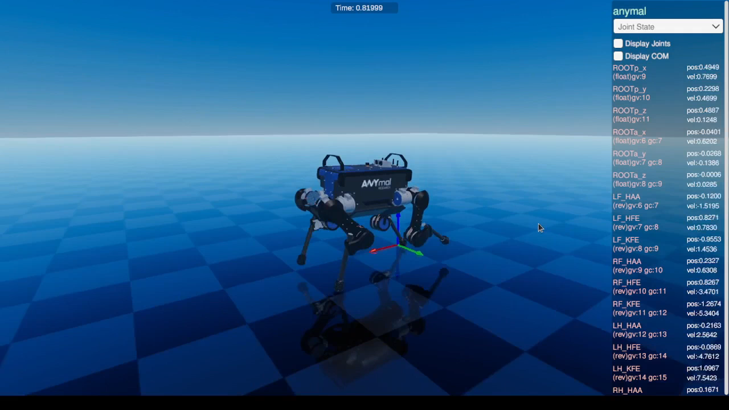
External disturbances (trot gait example)

Slide 22
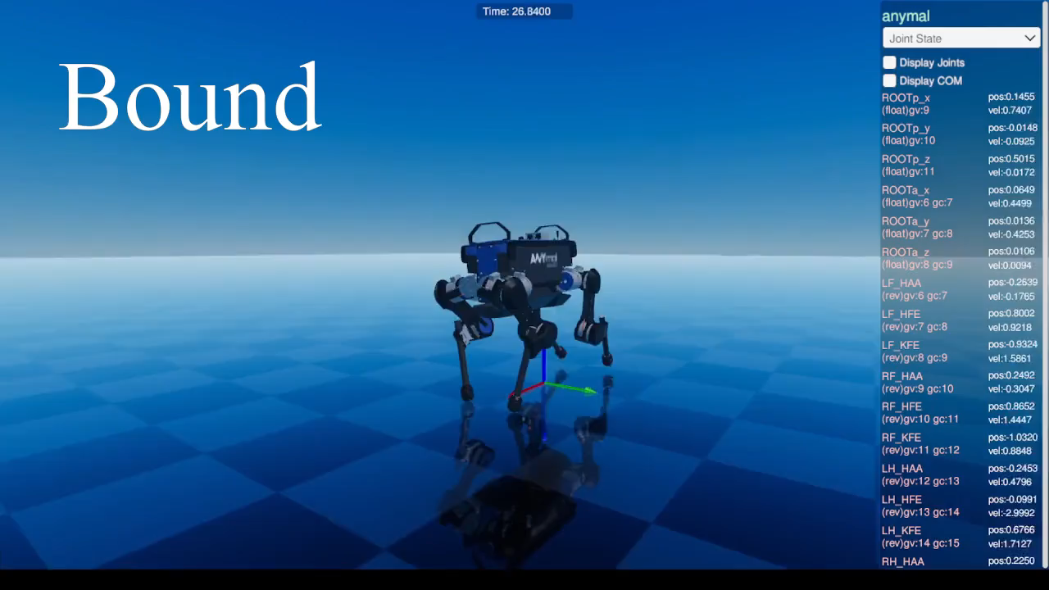
Gait transitions example (manual switching)

Slide 23
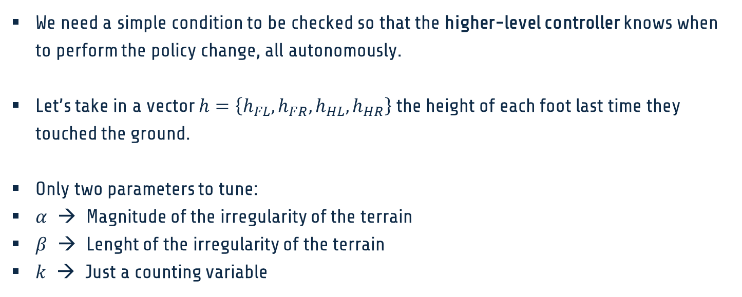
5. Personal contribution: Condition for autonomous transition
We need a simple condition to be checked so that the higher-level controller knows when to perform the policy change, all autonomously.
Let’s take in a vector $h=\left\{h_{FL},h_{FR},h_{HL},h_{HR}\right\}$ the height of each foot last time they touched the ground.
Only two parameters to tune:
$α$ → Magnitude of the irregularity of the terrain
$β$ → Lenght of the irregularity of the terrain
$k$ → Just a counting variable

Slide 24
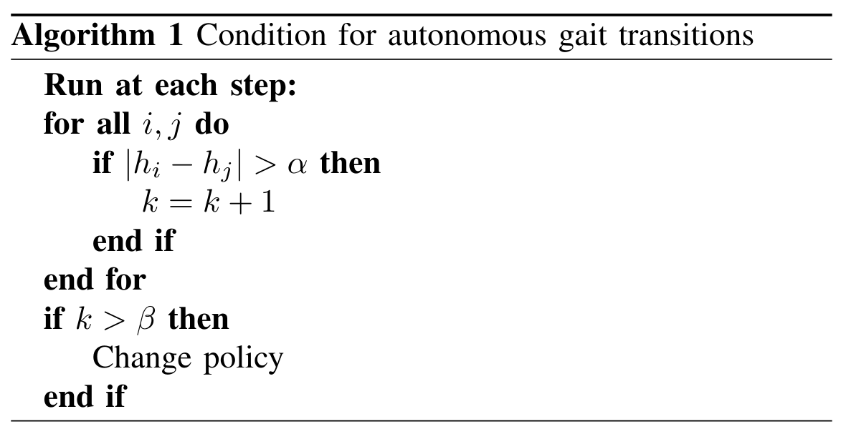
Pseudocode

Slide 25
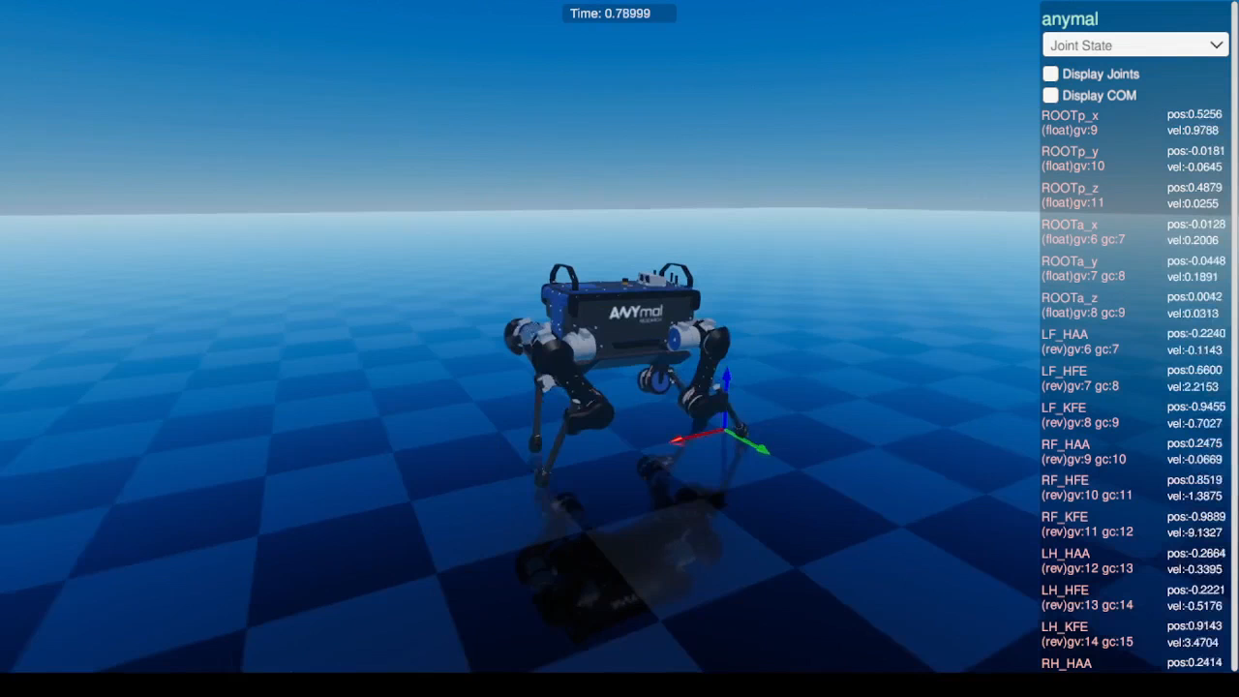

Autonomous change of gait ($α=0.2, β=1000$)

Slide 26
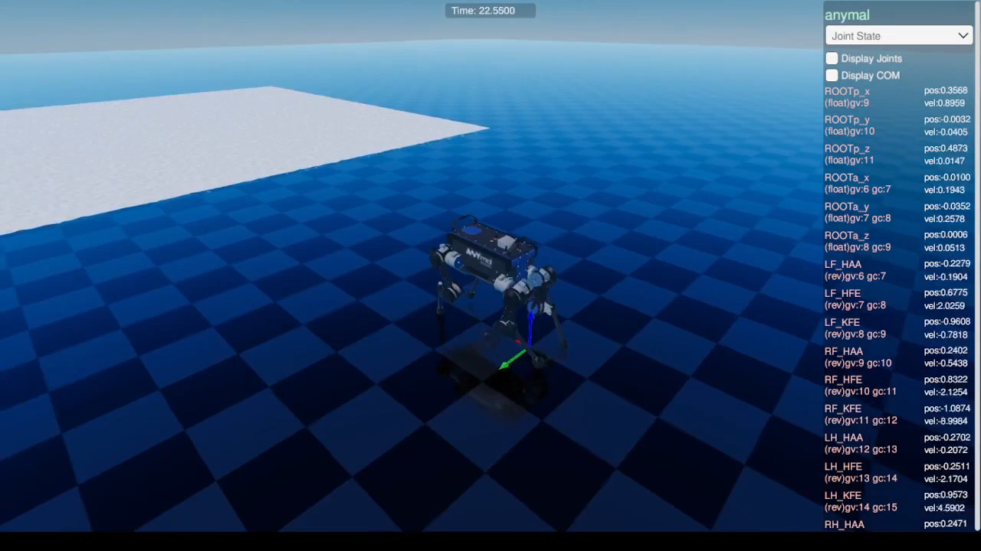
Autonomous change of gait (aerial view)

Slide 27
6. Conclusions
Single gaits were successfully learned thanks to deep reinforcement learning techniques
Reward Machines turned out to be crucial for the right gait learning
Transition between gaits were made robust randomizing the terrain, and applying external forces to the robot
Condition for autonomous gait change proved to be suitable for different terrain, and easy to tune according to the objective

Slide 28
Thanks.

